Slide 1
Scrum Framework
June 2013

Slide 2

What is Scrum?
An agile process to manage and control development work
A wrapper for existing engineering practices
Team-based way to iteratively, incrementally develop systems/products
Process controlling the chaos of conflicting interests and needs
A way to improve communications and maximize co-operation
Exposes impediments to developing and delivering products
Helps to maximize productivity
Scalable from single projects to entire organizations
Self-empowering
p 2
Notes:
Scrum is also:
scalable from single projects to entire organizations. Scrum has controlled and organized development and implementation for multiple interrelated products and projects with over a thousand developers and implementers.
a way for everyone to feel good about their job, their contributions, and that they have done the very best they possibly could.

Slide 3
Scrum Strengths
Prioritized delivery
Features are sequenced by business value
Non-prescriptive on practices performed during a sprint
Many teams use detailed XP practices inside the Scrum framework
Demonstrated success across the software industry
Scrum has been successful in multiple environments
Transparency
The daily meetings and artifacts expose problems early and often
Team accountability
Teams commit to the work that will be done during the sprint
Continuous delivery
Scrum delivers product features continuously
p 3

Slide 4

Scrum Process Flow
Daily Scrum
Meeting
24 hours
Backlog tasks
expanded
by team
2 -4 weeks
Sprint Backlog
Demonstrable
New Functionality
Product Backlog of User Stories
as prioritized by Product Owner
Source: Adapted from Agile Software Development with Scrum by Ken Schwaber and Mike Beedle.
p 4

Slide 5
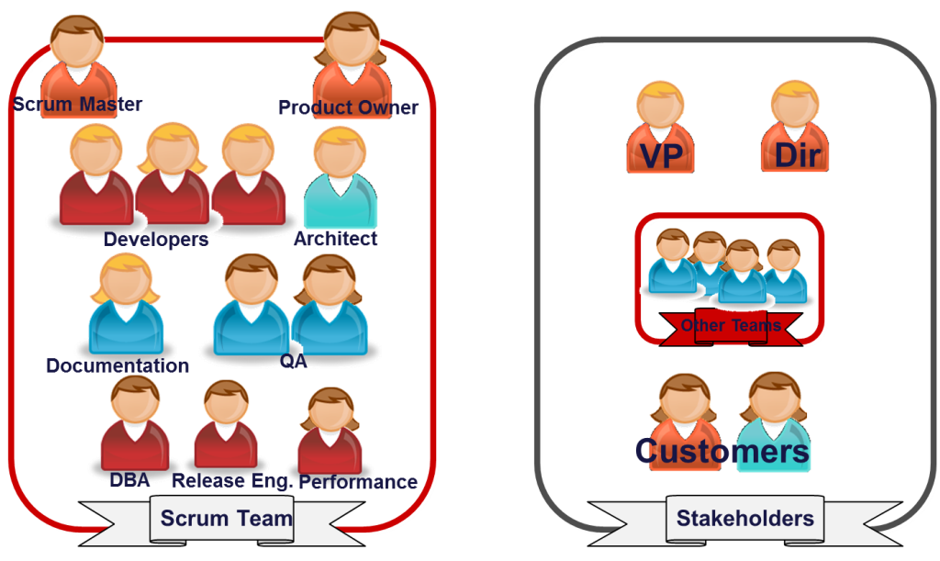
Scrum Roles and Responsibilities
Scrum defines three key roles
Product Owner
Scrum Master
Development Team
Product Owner | Scrum Master | Development Team
One person, not a committee Has authority to make decisions on behalf of the organization Understands the product and business direction Defines the features of the product Manages and prioritizes features and the product backlog Accepts or rejects work results | One person, not a committee Ensures the team is fully functional and productive Ensures the team understands and follows the principles of Scrum Removes impediments to the teams progress Shields the team from outside interference Facilitates Scrum events/meetings Promotes Scrum within the organization | Typically made up of 3 to 9 individuals Cross-functional… No titles or specialized areas of responsibility. There may be specific skill sets, but the team is ultimately responsible for delivering incremental functionality Self-organizing - Team decides how to break up and distribute the work Estimates amount of product backlog that can be delivered in a sprint Demonstrates work results to the Product Owner
p 5

Slide 6
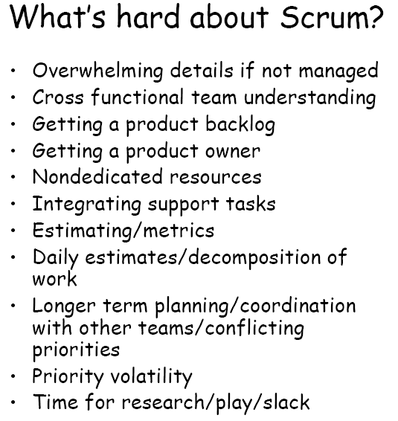
Scrum’s Challenges
Product Owner Challenges
Resisting the temptation to "manage" the team.
Resisting the temptation to add more important work after a sprint is already in progress.
Being willing to make hard choices during the Planning Meeting.
Balancing the interests of competing stakeholders.
Scrum Master Challenges
Resisting assigning work to team members.
Resisting the need to make the decision.
Reminding everyone of the Scrum rules.
Resisting the temptation to tradeoff quality in the face of pressure
p 6

Slide 7
Scrum Adapted to Common Process
Initiation
Planning - Sprint 0
Execution - Sprints 1-n
Determine Product Owner, Scrum Master, and team
Build product backlog (w/ story point estimates)
Sprint planning meeting to determine sprint backlog
Release - Sprint n+1
Closure
Conduct final retrospective
Execute implementation plan
Daily Scrum meetings
Determine non-functional requirements
Project approval and activation
Address architectural needs and environments
Daily Scrum meetings
Burn-down and velocity checks
Conduct sprint review
Conduct retrospective
Refine product backlog
Deliver training & transition to stakeholders
Release shippable product
Final sprint review
Perform project closure activities
Input from end-users, customers, team, and other stakeholders on key requirements
Develop project charter
p 7
Notes:
Remember – pure Scrum is a cultural change. Many organizations adopting Scrum don’t understand that or cannot effectively make the leap, but want to be “agile” to meet business requirements. Therefore, application of Scrum usually gets modified as part of the journey. This is just a possible representation.

Slide 8
Project Initiation and Kick-off
Initiation
Most companies require formal project selection and initiation processes
Project charters and detailed scope statements can still coincide with Scrum (some do this within “Sprint 0”)
Business requirements include everything from regulatory requirements to regulatory processes and deliverables that must be followed or completed
Don’t forget quality/compliance requirements and the deliverables required for certain projects and industries
Requirements formats, such as use case narratives, can be applied instead of user stories but still work for Scrum

Slide 9
Sprint 0: Planning
Planning - Sprint 0
Usually anywhere from 1-4 weeks prior to first Sprint
“Sprint Zero” is not technically considered Scrum… but, depending on size, complexity, “greenfield” vs. enhancement, new team etc., there is usually some type of prep work required prior to starting Sprint 1 once a formal project selection and/or initiation process has been followed
“Sprint 0” may be a good idea if you need it… use common sense! Other times you can jump right in and start doing development
Key activities typically include:
Team on-boarding, project overview and vision, roles and responsibilities overview
Preparing/ prioritizing backlog by talking to users/customers, story generation, prototyping the UI, and other activities
Choosing development platforms
Setting up working development environments, IDE’s, Hardware Software Infrastructure
p 9

Slide 10
Sprints 1-n: Execution
Execution - Sprints 1-n
Product Backlog
Reviewed & prioritized by the Product Owner and Scrum Master
Sprint Planning Meeting Solidifies Sprint Backlog
Product Owner presents stories for sprint and acceptance criteria
Team validates and clarifies User Stories
Team creates tasks for User Stories
Sprint Execution
Anywhere from 1 – 4 weeks; 2 or 3 is ideal
Daily Standup Meeting
Daily Burndown Chart published
Product Demonstration
Team demonstrates working software and acceptance stories as “done”
Retrospective
Team reviews achievements and identify key improvements for next sprint
p 10

Slide 11
Ceremonies
Event | Description | Key Artifacts
Sprint Planning Meeting | Product Owner presents the stories for the upcoming sprint Team commits to certain stories and develop the detailed task plan to deliver the stories | Sprint Backlog List of tasks to accomplish a story for this sprint; owned by the Team
Daily Standup | Daily 15 minutes meeting where each team member answers 3 questions: What did I accomplish yesterday What will I work on today What impediments are impeding my progress? | Impediments List Sprint Burndown Chart illustrating the team’s progress against a Sprint Goal
Product Demo | Team demonstrates the functioning software (completed stories) to the Product Owner and other stakeholders Product Owner accepts or rejects work | Working Software
Sprint Retrospective | Forum to “Inspect and Adapt” What did we do well? What can be improved? | Improvement areas prioritized based on team input
p 11

Slide 12
Final Release & Closure
Release - Sprint n+1
Closure
Training and transition requirements and processes may need additional roles/resources to release the product
Release and closure activities can still be time-boxed and follow Scrum-based processes to achieve final product release requirements for the business
Formal release processes between ITIL and Scrum can be achieved with proper planning

Slide 13
Key Points to the Adapted Process
Adapt the Scrum framework to fit within your company’s project initiation process and process closure process
Scrum is based on dedicated team members. Allocating members across projects and other work disruptions (e.g. production support) will disrupt the effective application of sprints
Many organizations have activities outside of the Scrum process that still need to be addressed, such as integration with ITIL processes
Prior to an official release of the product, but after the code has been considered “done”, an additional sprint may be needed at the end to officially launch the product (solution) into a production environment
A PMBOK-based framework and Scrum can coincide

Slide 14
Example Scrum Ceremony Agendas

Slide 15
Sprint Planning Meeting Checklist
Attendees: Product Owner, Team, ScrumMaster/Project Manager
Common Obstacle: Diving into too much detail and design/feature – ID tasks
Key Considerations:
The team always has the final say when it comes to estimating
Every team member should have a vote and/or voice
Dependencies should be minimized, if not prevented entirely
The team should consistently identify any impediments preventing them from completing their work that need to be addressed
Agenda:
Product Owner and team review and clarify each item
Larger stories are broken down as necessary
Team estimates any resulting new stories
Team selects the stories they can complete within the iteration
Team ideally defines the iteration goal or theme
Team breaks each story into tasks and clearly defined acceptance criteria
Team estimates each task, typically in hours
Team members sign up for tasks initially during the iteration
Team may review the workload to make certain it is feasible and balanced
Product Owner agrees with the work that will be completed

Slide 16
Sprint Planning Meeting Checklist
Inputs
Prioritized product backlog
Prior Velocity
Outputs
Iteration goal
Acceptance tests
Team member capacity
Schedule Risks
Other known issues/risks
Story tasks
Task estimates

Slide 17
Daily Standup Meeting Checklist
Attendees: Product Owner, Team, ScrumMaster/Project Manager, Interested Stakeholders
Common Obstacles:
All team members not present
Non-core team members consume the meeting
General discussion/tangents
Key Considerations:
Only people with work assigned should speak
Other topics should be addressed outside of the meeting
Team should report progress to team
Note impediments/issues; discuss after the “16th” minute
Agenda:
What have you done since we last met?
What are you planning to do until we meet again?
What, if any, impediments are you encountering that are preventing you from making forward progress?

Slide 18
Daily Standup Meeting Checklist
Inputs
Individual team member’s state of work currently and completed
Outputs
Team communication and understanding of individual and iteration progress
Task status
Critical issues or impediments

Slide 19
Sprint Review Meeting Checklist
Attendees: Product Owner, Team, ScrumMaster/Project Manager, Stakeholders
Key Considerations:
“Just say no” to Powerpoint slide decks or feature dissertations
The Product Owner may decide not to accept certain functionality
Agenda:
Team walks through completed functionality with Product Owner
Team identifies any incomplete stories
The Product Owner moves and/or splits incomplete stories or backlog items into next iteration or back into product backlog if not longer a priority
Product Owner closes out iteration and accepts appropriate functionality
Team demonstrates working software to interested stakeholders
Any open issues/impediments and action items are noted and assigned

Slide 20
Sprint Review Meeting Checklist
Inputs
Working tested software
Outputs
Final acceptance of completed functionality
Resolution to any incomplete items
Product backlog updated and prepped

Slide 21
Sprint Retrospective Meeting Checklist
Attendees: Product Owner, Team, ScrumMaster/Project Manager
Key Considerations:
Always remember, and remind the team, that retrospectives are intended to focus on the process and not the people
Whoever facilitates should make an effort to ensure all team members participate
Agenda:
Team reviews what went well during the last iteration
Team reviews what didn’t go as well or as planned during the last iteration and why
Team identifies the most important items or issues to focus on next iteration
Team notes any additional impediments preventing them from adopting and/or improving their process

Slide 22
Sprint Retrospective Meeting Checklist
Inputs
Details and accomplishments from the prior iteration
Outputs
Prioritized impediments or newly identified stories for action in an upcoming iteration
List of issues or impediments

Slide 23
Example Scrum Artifacts

Slide 24
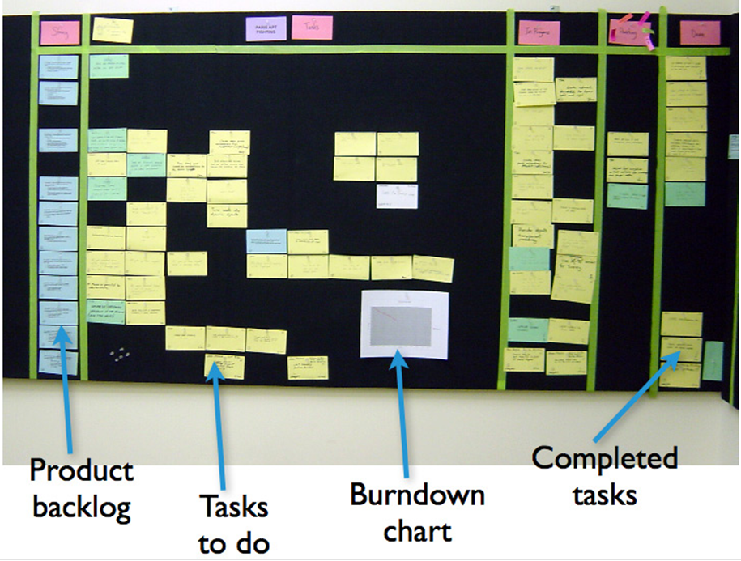
Artifact: Task Board
A task board hanging in a team room
p 24

Slide 25
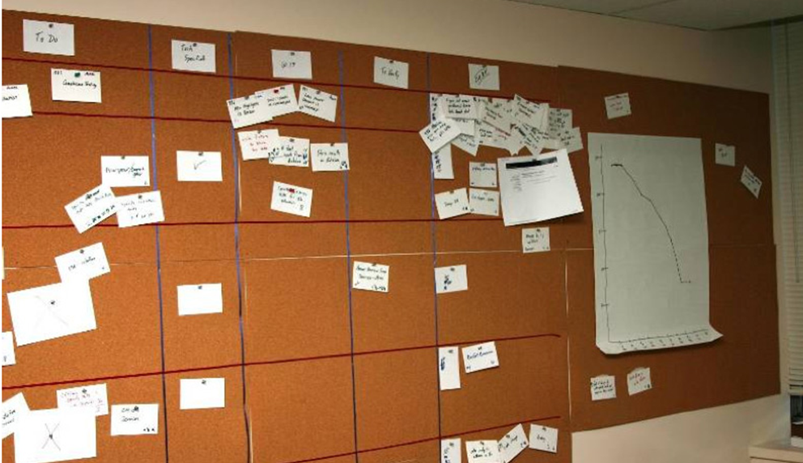
Artifact: Task Board
A Cork board hung on the wall
p 25

